Slide 1
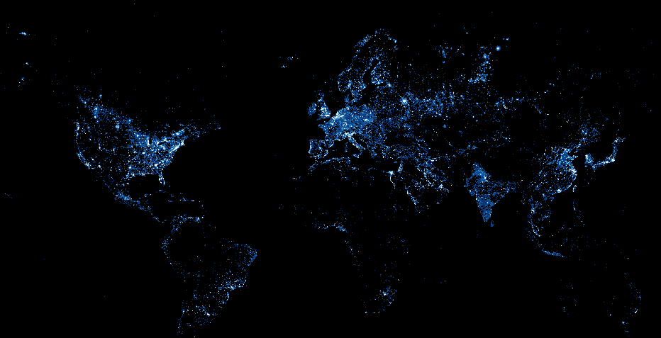
Revealing Economic Growth Using Satellite Night Imagery
Peter Rasmussen
Notes:
Hi my name is Peter Rasmussen and my talk is on Revealing Economic Growth Using Satellite Night Imagery
Having worked in multiple Sub-Saharan African countries,
I can attest to fact that socioeconomic data that is readily available in places like the US – that we take for granted - is often not there in emerging markets
This is because traditional means of getting socioeconomic data can be imprecise or unavailable
For certain countries, it can be difficult to even get country-level data, let alone subnational data at the provincial and city levels
And getting good data is important
For instance, GDP data is valuable to governments to make policy, investors and consultancies are interested in sizing a given market, local companies, and the aid agencies use the information to develop more targeted, impactful programs
Currently, a lot of this information is simply unavailable

Slide 2
Issue: Data gaps in emerging markets
GDP
Afghanistan
Syria
Notes:
So let’s see an illustration of this issue using GDP data for two countries that have endured civil war
There are gaps in GDP data

Slide 3
Issue: Data gaps in emerging markets
GDP
Afghanistan
Syria

Slide 4
Issue: Data gaps in emerging markets
How do we measure economic growth in places where statistics are imprecise or unavailable?

Slide 5
Hypothesis
We can use satellite night light imagery to measure GDP
Notes:
During times when economic data couldn’t be collected, the satellites were collecting imagery data from above
We can use that historical data to fill in the gaps for gdp data
We can also use current data to estimate gdp of cities in emerging markets, data which isn’t readily available

Slide 6
Methodology
Data
Analysis
~200 country-level regressions
400+ city GDP estimates
Comparison to other datasets
Notes:
Data from NOAA: 1992 to 2013
GDP data from World Bank
250 country-level linear regressions to model how light intensity correlates with given country’s GDP
Then, I conducted the analysis for cities with populations greater than 1 million (as of 2009) to measure GDP at the local level

Slide 7
Results: Country-Level Regressions
r²
0.12
0.92
Notes:
Emerging markets tend to correlate to light better than developed / industrialized markets
Correlation for developed / industrialized countries may be poorer because 1) they are already electrified, 2) institution of light pollution regs, 3) energy efficiency iniatives

Slide 8
Results: Syria Case Study
Emerging market that was growing at a rapid rate until civil war began in 2011
.
.
.
GDP data unavailable from 2008 onwards
Notes:
Here we see intertemporal night light data for Syria, Afghanistan, and Somalia
We can use this information to fill in the gaps in GDP data

Slide 9
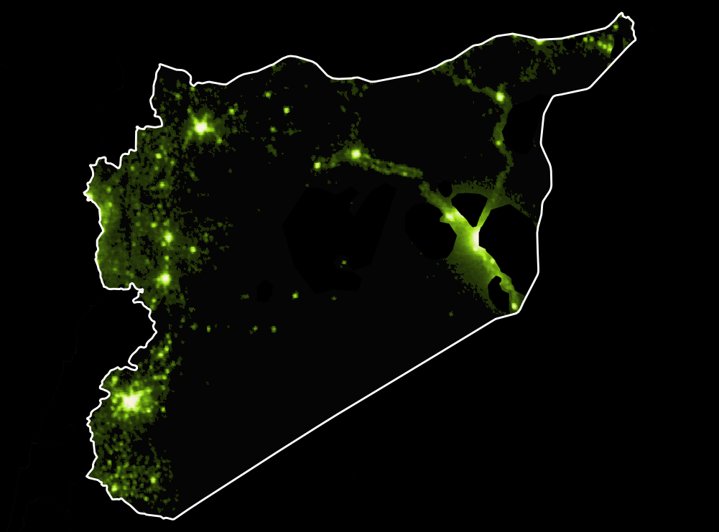
1992

Slide 10
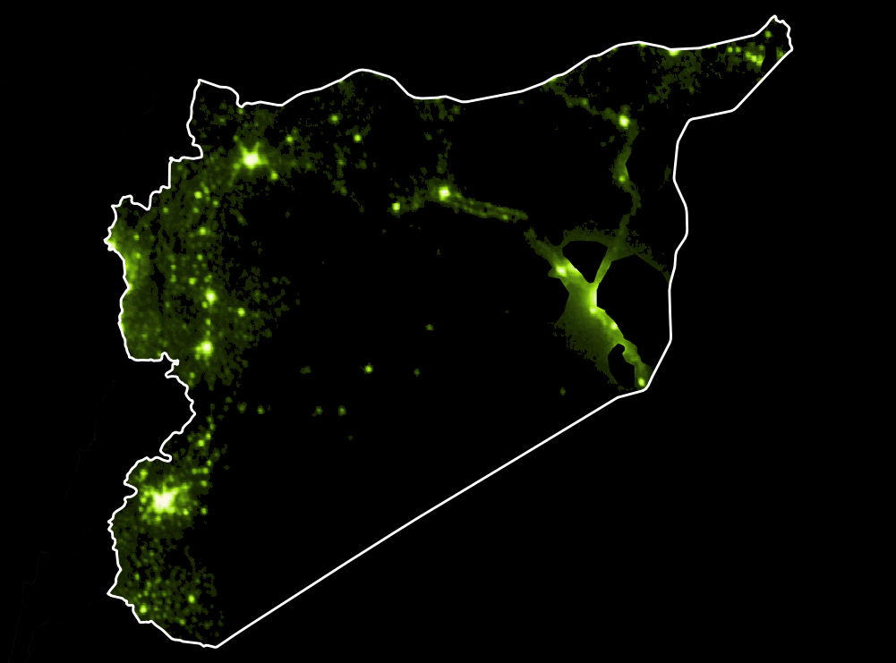
1993

Slide 11
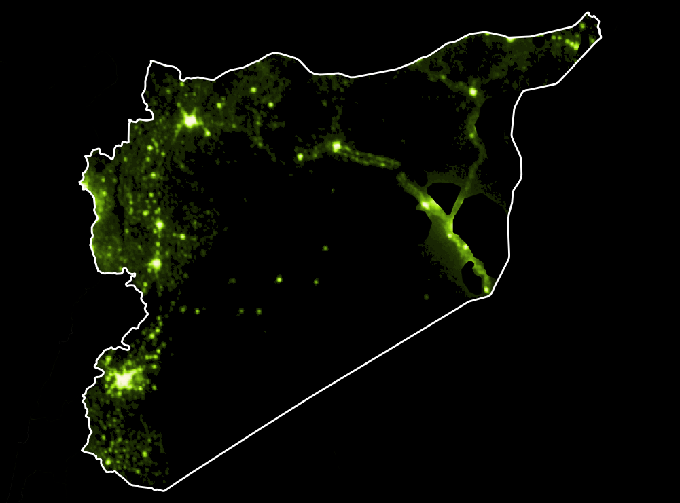
1994

Slide 12
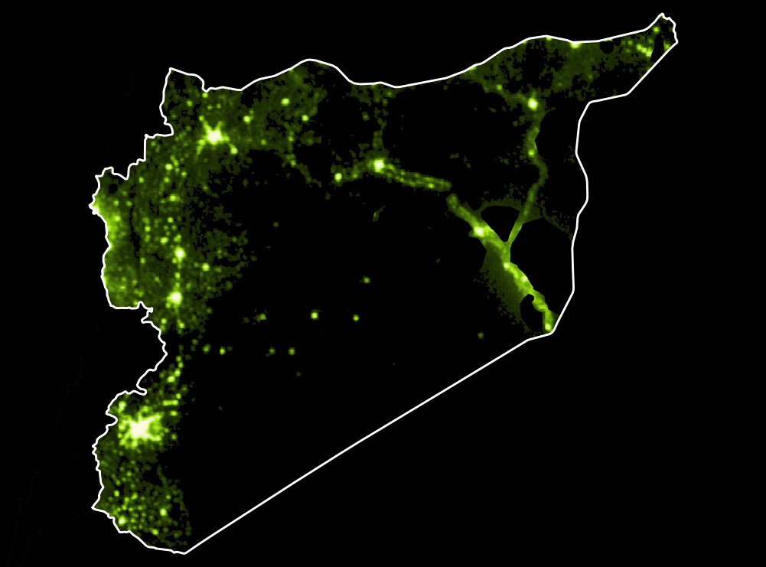
1995

Slide 13

1996

Slide 14
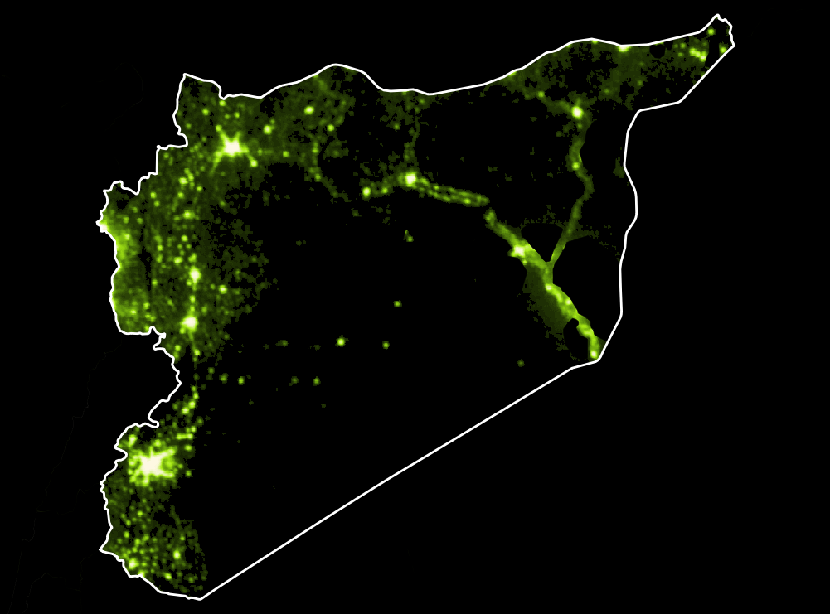
1997

Slide 15
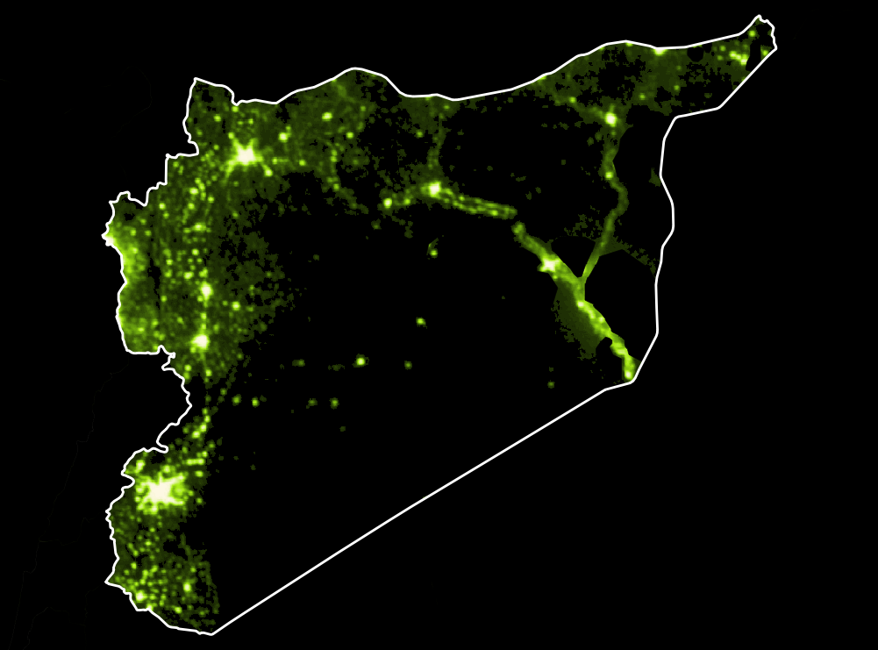
1998

Slide 16
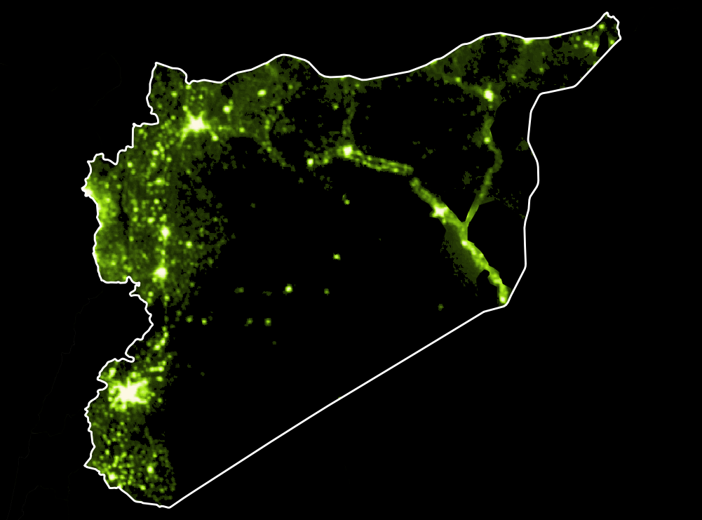
1999

Slide 17

2000

Slide 18
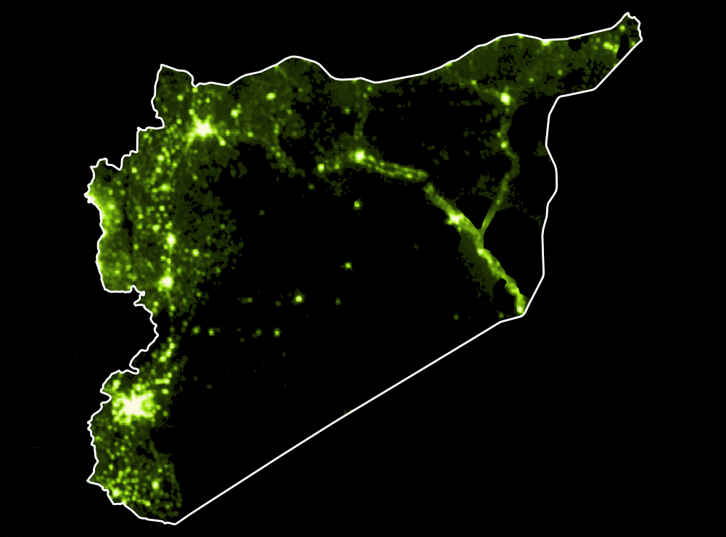
2001

Slide 19

2002

Slide 20
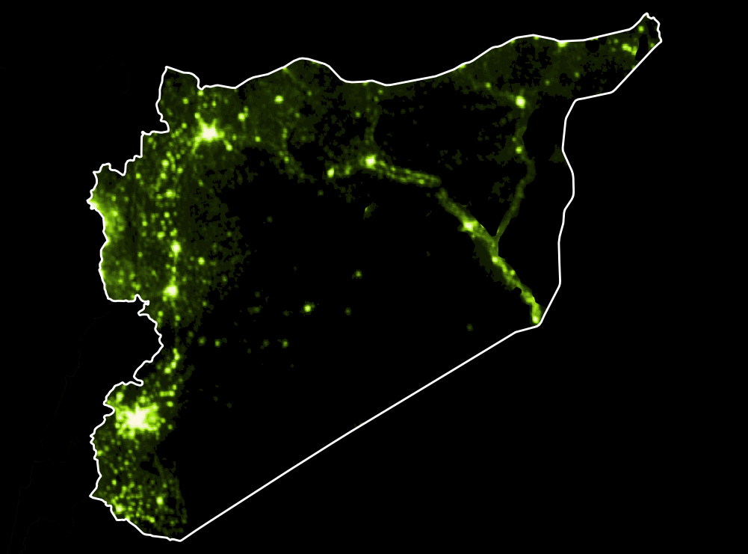
2003

Slide 21
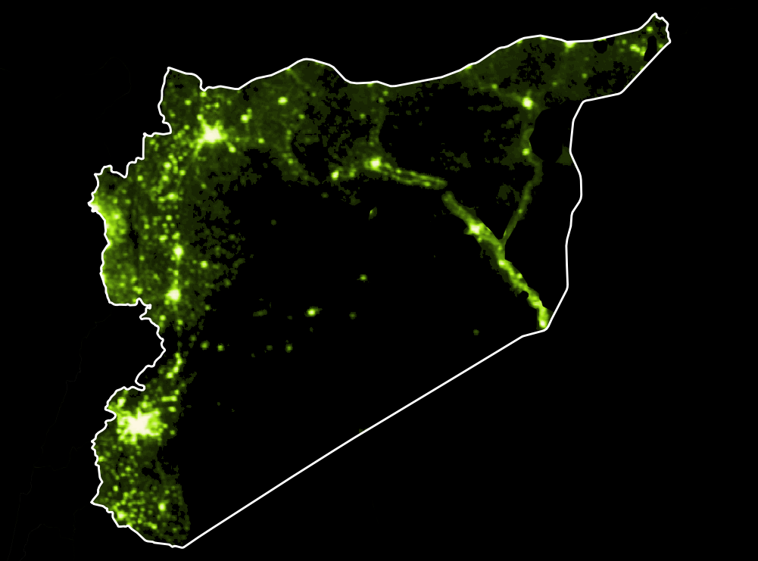
2004

Slide 22

2005

Slide 23

2006

Slide 24

2007

Slide 25

2008

Slide 26

2009

Slide 27
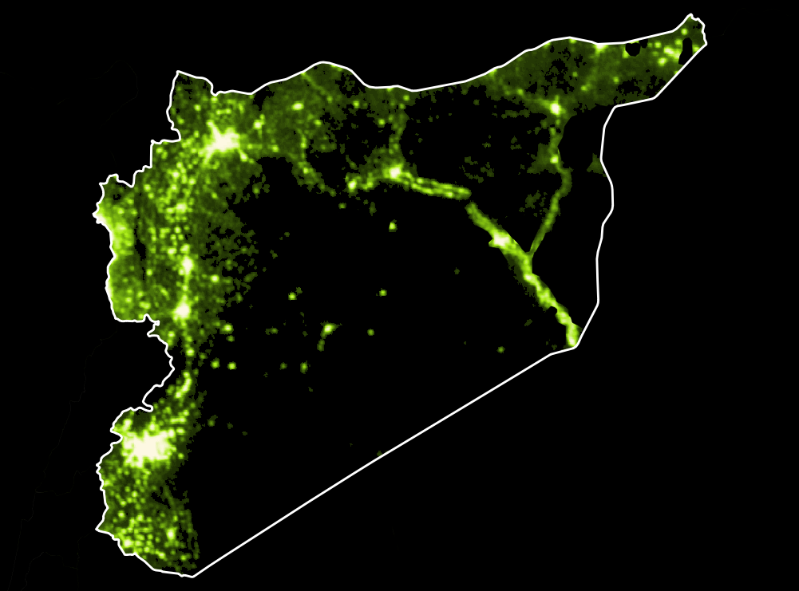
2010

Slide 28
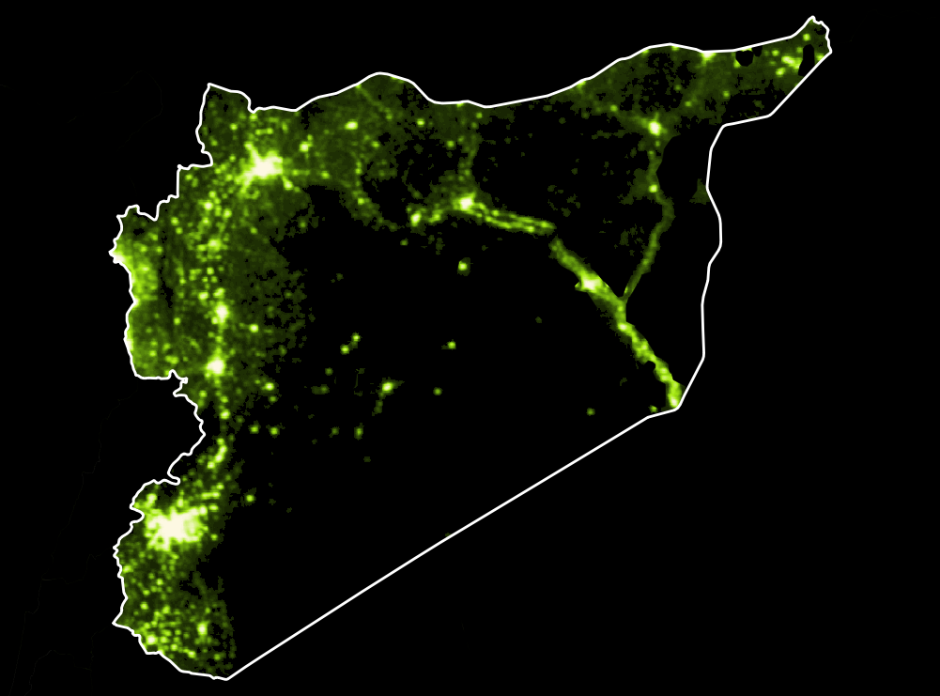
Civil War
2011

Slide 29

Civil War
2012

Slide 30
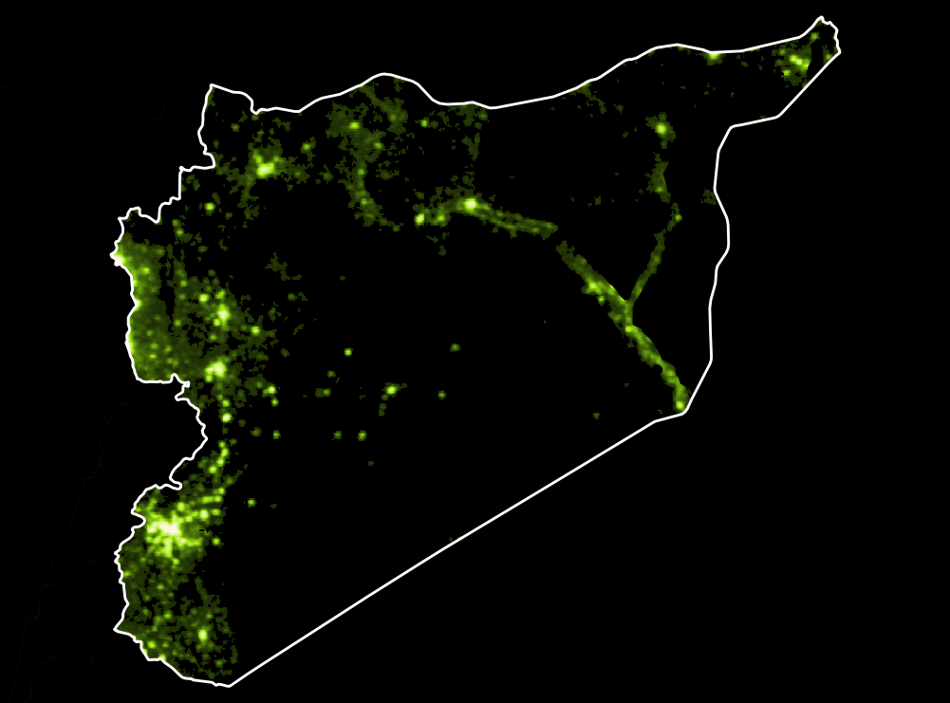
Civil War
2013

Slide 31
Issue: Data gaps in emerging markets
GDP
Afghanistan
Syria

Slide 32
Issue: Data gaps in emerging markets
GDP
Afghanistan
Syria
Notes:
Here we see how we can use light imagery data to fill those gaps

Slide 33
Where Do We Go from Here?
Estimate economic growth at subnational level
Improve regression by 1) using other models and 2) introducing other spatial and non-spatial data
Use light data to estimate other spatial variables, such as population and per capita income

Slide 34
Where Do We Go from Here?
Estimate economic growth at subnational level
Improve regression by 1) using other models and 2) introducing other spatial and non-spatial data
Use light data to estimate other spatial variables, such as population and per capita income

Slide 35
Where Do We Go from Here?
Estimate economic growth at subnational level
Improve regression by 1) using other models and 2) introducing other spatial and non-spatial data
Use light data to estimate other spatial variables, such as population and per capita income

Slide 36
Thank You!
Blog
pgr-me.github.io
peter.gray.rasmussen@gmail.com
pgr-me
petergrayrasmussen

